Slide 1

DEE 4544 DIGITAL ELECTRONICS Chapter 5: Introduction to State Machines.
By : Dr. Noraisyah Tajudin
Email: noraisyahtajudin@lincoln.edu.my
Faculty of Engineering
Lincoln University College (LUC)
LECTURE 5
DATE : APRIL 2024

Slide 2
Course content outline.
To understand the State Machines and their need.
To understand the Basic Concepts in State Machine Analysis.

Slide 3
Sequential Circuits
Storage
elements
A combinational circuit and storage elements are interconnected to form a sequential circuit.
The information stored at any time defines the state of the circuit at that time.
The next state of the storage elements is a function of the inputs and the present state.
Synchronous sequential circuit can be defined from the knowledge of its signals at discrete instants.

Slide 4
Logic blocks are classified as:
Combinational and
Sequential
Does sequential logic contain both combinational logic and memory?
Yes
No

Slide 5
Combinational and Sequential Logic
Combinational logic does not have memory
It generates output solely according to the input and does not care about history
Often, we need a different reaction on the same input depending on the current state
E.g.
Current state is 7 and input is 1, the new state and output are 8
Current state is 15 and input is 1, the new state and output are
To make the new state depends on the previous state, we need memory

Slide 6
Sequential Logic and FSM
Computers are made of sequential logic blocks
Truth tables are used to design combinational logic, but can’t be used to design sequential logic
Finite state machines (FSM) are used instead
FSM describes a sequential logic block in terms of:
Set of states,
State transition function (defined on current state and input), and
Output function (defined on current state and input, or on current state only)

Slide 7
Why State Machines?
Goal: provide simple abstractions of complex systems
All computer systems are state machines
registers and memory are state
changes are transitions between states
a program defines the way in which initial states are transformed into final states
a programming language determines a set of programs (and hence, a set of machines)
Primary challenge will be to represent these very complex machines with simpler (more abstract) machines that we can reason about

Slide 8
State Machines Are Often Used
When it is possible to abstract away irrelevant details, leaving only a small number of states
When we want to examine every possibility using exhaustive checking
For communication protocols and complex distributed algorithms (e.g., cache coherency)

Slide 9
Informally ...
A state machine captures the idea that a system progresses through a set of states by performing (or responding to) a set of actions.
Thus there are two key concepts
States
Actions
A state machine definition must say
what the possible states are
what initial states the machine may start in
what the possible actions are
how the state changes when actions occur

Slide 10
A (Very) Simple State Machine
World's simplest state machine
States: {stop}
Actions: {}
Initial state: {stop}
stop

Slide 11
Another Simple Example
alarm
beep
States: {alarm}
Actions: {beep}
Initial state: {alarm}

Slide 12
Moore vs. Mealy Machines
Definitions
Moore Machine
Outputs are function
solely of the current
state
Outputs change
synchronously with
state changes
Mealy Machine
Outputs depend on
state AND inputs
Input change causes
an immediate (asynchronous)
output change
Mealy only; no connection for Moore
X
Inputs
State
Register
Combinational
Logic for
Next State
(FF Inputs)
Comb.
Logic for
Outputs)
Z
Outputs
State
Feedback
Clock

Slide 13
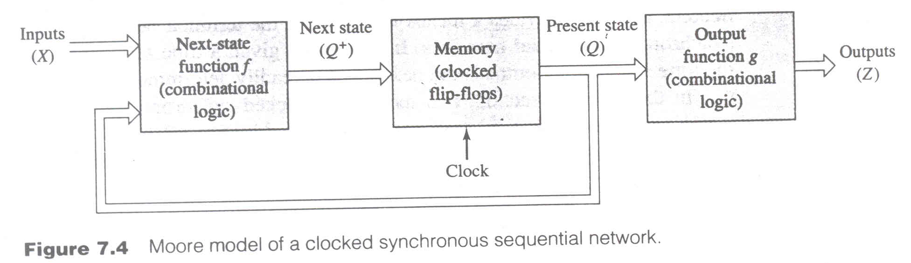
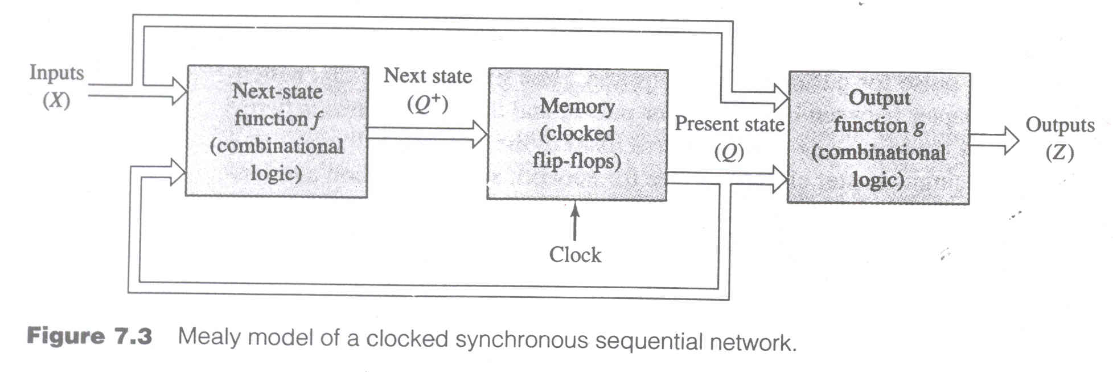
Moore

Slide 14
Moore machines are faster
Mealy machines are smaller
Any Moore machine can be turned into a Mealy machine (and vice versa)

Slide 15
Transition Tables :
Instead of using algebraic equations for next state and outputs of sequential network, it is more convenient and useful to express the information in tabular form.
The Transition Table or State Transition Table or State Table is the tabular representation of the transition and output equations. This table consist of Present State, Next State, external inputs and output variables. If there are n state variables then 2^{n} rows are present in state table.
State machine notations :
Input Variables : External input variables to sequential machine as inputs.

Slide 16
Output Variables : All variables that exit from the sequential machine are output variables.
State : State of sequential machine is defined by the content of memory, when memory is realized by using FFs.
Present State : The status of all state variable i.e. content of FF for given instant of time t is called as present state.
Next State : The state of memory at t+1 is called as Next state.
State Diagram : State diagram is graphical representation of state variables represented by circle. The connection between two states represented by lives with arrows and also indicates the excitation input and related outputs.

Slide 17
Sequential Circuit Analysis (cont.)
Generate State Diagram
Circles (nodes) represent current or present state values
Lines (arcs) represent how state and output values change
Given the current state and current inputs, the next state and output values are indicated by the associated arc
State diagram can have different forms depending on the type of sequential circuit output.
Inputs/outputs
Next
State
Value
Present
State
Value

Slide 18
Output Variables : All variables that exit from the sequential machine are output variables.
0X
A
0
Q→0
11/10
Application Table of FF
PS | NS | FF input
Q | Q⁺ | J | K
0 | 0 | 0 | X
0 | 1 | 1 | X
1 | 0 | X | 1
1 | 1 | X | 0
11/01
B
1
Q→1
x0
State diagram of J-K FF

Slide 19
10
01
00
10
0
1
Application Table of FF
00
01
PS | NS | FF i/p
Q | Q⁺ | S | R
0 | 0 | 0 | X
0 | 1 | 1 | 0
1 | 0 | 0 | 1
1 | 1 | X | 0
State diagram of SR FF

Slide 20
1
0
0
1
1
Application Table of FF
0
PS | NS | FF i/p
Q | Q⁺ | D i/p
0 | 0 | 0
0 | 1 | 1
1 | 0 | 0
1 | 1 | 1
State diagram of D FF

Slide 21
1
0
0
1
0
Application Table of FF
1
PS | NS | FF i/p
Q | Q⁺ | T i/p
0 | 0 | 0
0 | 1 | 1
1 | 0 | 1
1 | 1 | 0
State diagram of T FF

Slide 22
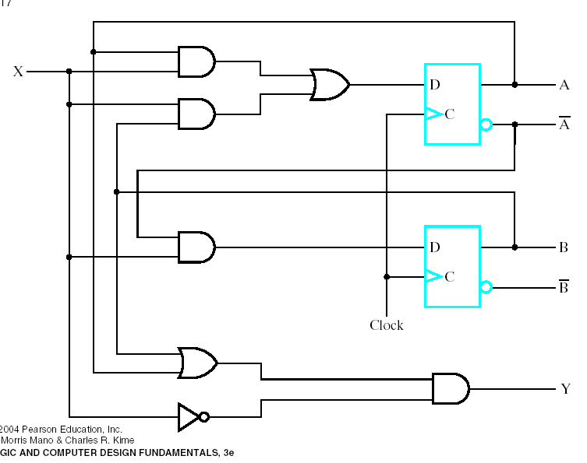
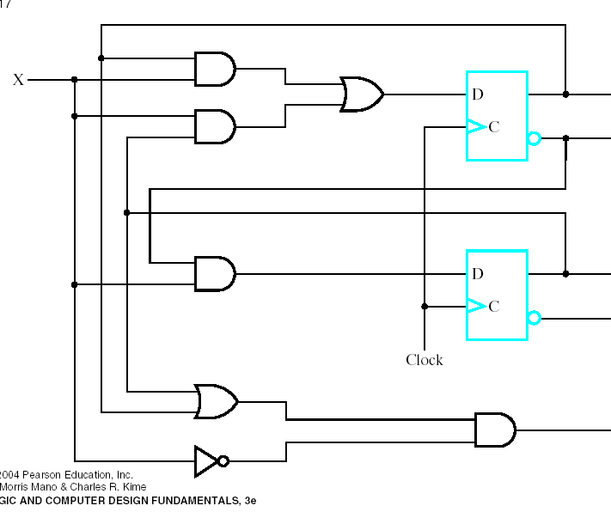
Analysis of Sequential Circuits
Example 2
FF input Equations:
DA=AX+BX
DB=A’X
A+=DA
B+=DB
Output:
Y=X’(A+B)

Slide 23
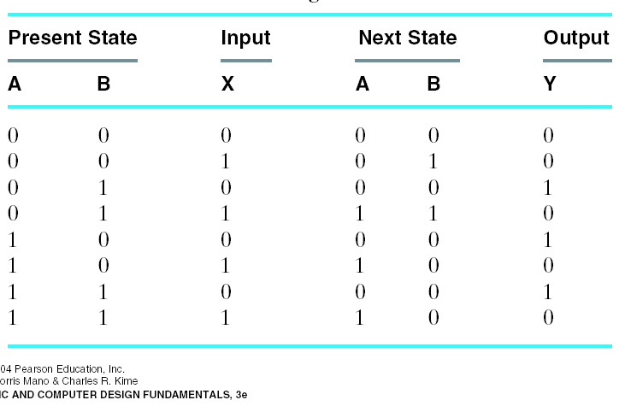
Analysis of Sequential Circuits
State Table:

Slide 24
Basic Design Approach
Sequential Circuit design: Reverse of analysis
State diagram State table next s.e.
FF input eq. Circuit Diagram
Six Step Process
1. Understand the statement of the Specification
2. Obtain an abstract specification of the SSC
3. Generate State Table
4. Perform state assignment
5. Choose FF types to implement SSC state register
6. Implement the SSC

Slide 25
Sequential Circuit Design
Design a sequence detector for the string “1101”. The output must be ‘1’ when the input matches this string
x
Sequence
detector
w
clock

Slide 26
Sequential Circuit Design
Mealy state machine (remember that in this state machine the output is dependent on input changes and states)
1/0
1/0
1/0
0/0
0/0
A
B
C
D
0/0
1/1
0/0
Assign binary values to each state. Example:
A = 00, B = 01, C = 11, D = 10

Slide 27
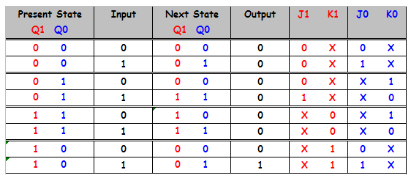
Sequential Circuit Design
Make Table FROM present state & input TO next state & output, and FF inputs.
A
B
C
D

Slide 28
Sequential Circuit Design
K-maps of the states & the outputs
Q1 Q0
Output = IQ1Q0’
I
Q1 Q0
J1
Q1 Q0
= IQ0
K1
= Q0’
I
I
Q1 Q0
J0 = I
Q1 Q0
K0 = I’
I
I

Slide 29
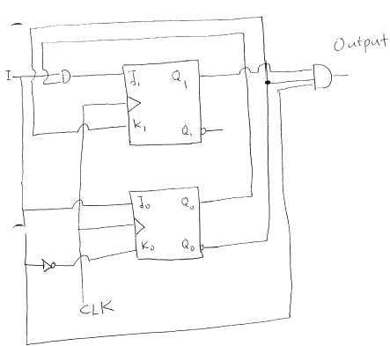
Sequential Circuit Design
Layout Diagram
J1 = IQ0
K1 = Q0’
J0 = I
K0 = I’
Output = IQ1Q0’

Slide 30
Sequential Circuit Design
Moore State Machine for the sequence detector 110
1
1
1
0
0
A/0
B/0
C/0
D/1
0
1
0
state
A
B
C
D
A

Slide 31

Summary
Finite state machines form the basis of many digital systems
Designs often start from clear specifications
Develop state diagram and state table
Optimize using combinational design techniques
Mealy or Moore implementations possible
Can model approach using HDL.

Slide 32
Thank You

